Slide 1
The Kruskal-Wallis Test
Nonparametric test to compare outcomes among more than two independent groups is the Kruskal Wallis test. The Kruskal Wallis test is used to compare medians among k comparison groups (k > 2) and is sometimes described as an ANOVA with the data replaced by their ranks. The null and research hypotheses for the Kruskal Wallis nonparametric test are stated as follows:
H₀: The k population medians are equal versus
H₁: The k population medians are not all equal
The procedure for the test involves pooling the observations from the k samples into one combined sample, keeping track of which sample each observation comes from, and then ranking lowest to highest from 1 to N, where N = n₁+n₂ + ...+ n_{k}. To illustrate the procedure, consider the following example.

Slide 2
The Kruskal-Wallis Test – Example
A clinical study is designed to assess differences in albumin levels in adults following diets with different amounts of protein. Low protein diets are often prescribed for patients with kidney failure. Albumin is the most abundant protein in blood, and its concentration in the serum is measured in grams per deciliter (g/dL). Clinically, serum albumin concentrations are also used to assess whether patients get sufficient protein in their diets. Three diets are compared, ranging from 5% to 15% protein, and the 15% protein diet represents a typical American diet. The albumin levels of participants following each diet are shown below.

Slide 3
5% Protein | 10% Protein | 15% Protein
3.1 | 3.8 | 4.0
2.6 | 4.1 | 5.5
2.9 | 2.9 | 5.0
 | 3.4 | 4.8
 | 4.2
Is there is a difference in serum albumin levels among subjects on the three different diets. For reference, normal albumin levels are generally between 3.4 and 5.4 g/dL. By inspection, it appears that participants following the 15% protein diet have higher albumin levels than those following the 5% protein diet. The issue is whether this observed difference is statistically significant.

Slide 4
Solution
 |  |  | Total Sample (Ordered Smallest to Largest) |  |  | Ranks
5% Protein | 10% Protein | 15% Protein | 5% Protein | 10% Protein | 15% Protein | 5% Protein | 10% Protein | 15% Protein
3.1 | 3.8 | 4.0 | 2.6 |  |  | 1
2.6 | 4.1 | 5.5 | 2.9 | 2.9 |  | 2.5 | 2.5
2.9 | 2.9 | 5.0 | 3.1 |  |  | 4
 | 3.4 | 4.8 |  | 3.4 |  |  | 5
 | 4.2 |  |  | 3.8 |  |  | 6
 |  |  |  |  | 4.0 |  |  | 7
 |  |  |  | 4.1 |  |  | 8
 |  |  |  | 4.2 |  |  | 9
 |  |  |  |  | 4.8 |  |  | 10
 |  |  |  |  | 5.0 |  |  | 11
 |  |  |  |  | 5.5 |  |  | 12

Slide 5
Example Continue
Notice that the lower ranks (e.g., 1, 2.5, 4) are assigned to the 5% protein diet group while the higher ranks (e.g., 10, 11 and 12) are assigned to the 15% protein diet group. Again, the goal of the test is to determine whether the observed data support a difference in the three population medians. Recall in the parametric tests, discussed in the modules on hypothesis testing, when comparing means among more than two groups we analyzed the difference among the sample means (mean square between groups) relative to their within group variability and summarized the sample information in a test statistic (F statistic). In the Kruskal Wallis test we again summarize the sample information in a test statistic based on the ranks.

Slide 6

Test Statistic for the Kruskal Wallis Test
k - the number of comparison groups
N - the total sample size,
n_{j} - is the sample size in the j^{th} group and R_{j} is the sum of the ranks in the j^{th} group.
In this example R₁ = 7.5, R₂ = 30.5, and R₃ = 40. Recall that the sum of the ranks will always equal n(n+1)/2. As a check on our assignment of ranks, we have n(n+1)/2 = 12(13)/2=78 which is equal to 7.5+30.5+40 = 78. The H statistic for this example is computed as follows:

Slide 7
Continue
In this example R1 = 7.5, R2 = 30.5, and R3 = 40. Recall that the sum of the ranks will always equal n(n+1)/2. As a check on our assignment of ranks, we have n(n+1)/2 = 12(13)/2=78 which is equal to 7.5+30.5+40 = 78. The H statistic for this example is computed as follows:
We must now determine whether the observed test statistic H supports the null or research hypothesis. Once again, this is done by establishing a critical value of H. If the observed value of H is greater than or equal to the critical value, we reject H0 in favor of H1; if the observed value of H is less than the critical value we do not reject H0. The critical value of H can be found in the table

Slide 8
Example Continue
To determine the appropriate critical value we need sample sizes (n₁=3, n₂=5 and n₃=4) and our level of significance (α=0.05). For this example the critical value is 5.656, thus we reject H₀ because 7.52 > 5.656.
Conclusion: There is a difference in median albumin levels among the three different diets.
You can find Tables contains critical values for the Kruskal Wallis test for tests comparing 3, 4 or 5 groups with small sample sizes. If there are 3 or more comparison groups and 5 or more observations in each of the comparison groups, it can be shown that the test statistic H approximates a chi-square distribution with df=k-1. Thus, in a Kruskal Wallis test with 3 or more comparison groups and 5 or more observations in each group, the critical value for the test can be found in the table of Critical Values of the χ ²

Slide 9
One More Example - The Kruskal-Wallis Test
A personal trainer is interested in comparing the anaerobic thresholds of elite athletes. Anaerobic threshold is defined as the point at which the muscles cannot get more oxygen to sustain activity or the upper limit of aerobic exercise. It is a measure also related to maximum heart rate. The following data are anaerobic thresholds for distance runners, distance cyclists, distance swimmers and cross-country skiers.

Slide 10
Data
Distance Runners | Distance Cyclists | Distance Swimmers | Cross-Country Skiers
185 | 190 | 166 | 201
179 | 209 | 159 | 195
192 | 182 | 170 | 180
165 | 178 | 183 | 187
174 | 181 | 160 | 215
Is a difference in anaerobic thresholds among the different groups of elite athletes?

Slide 11
Solution
Step 1. Set up hypotheses and determine level of significance.
H0: The four population medians are equal versus
H1: The four population medians are not all equal α=0.05
Step 2. Select the appropriate test statistic.
The test statistic for the Kruskal Wallis test is denoted H and is defined as follows:
where k=the number of comparison groups, N= the total sample size, nj is the sample size in the jth group and Rj is the sum of the ranks in the jth group.

Slide 12
Solution
Total Sample (Ordered Smallest to Largest) |  |  |  | Ranks
Distance Runners | Distance Runners | Distance Runners | Distance Runners | Distance Runners | Distance Cyclists | Distance Swimmers | Cross-Country Skiers
 |  | 159 |  |  |  | 1
 |  | 160 |  |  |  | 2
165 |  |  |  | 3
 |  | 166 |  |  |  | 4
 |  | 170 |  |  |  | 5
174 |  |  |  | 6
 | 178 |  |  |  | 7
179 |  |  |  | 8
 |  |  | 180 |  |  |  | 9
 | 181 |  |  |  | 10
 | 182 |  |  |  | 11
 |  | 183 |  |  |  | 12
185 |  |  |  | 13
 |  |  | 187 |  |  |  | 14
 | 190 |  |  |  | 15
192 |  |  |  | 16
 |  |  | 195 |  |  |  | 17
 |  |  | 201 |  |  |  | 18
 | 209 |  |  |  | 19
 |  |  | 215 |  |  |  | 20
 |  |  |  | R₁=46 | R₂=62 | R₃=24 | R₄=78

Slide 13
Solution – Continue
Step 3. Set up the decision rule.
Because there are 4 comparison groups and 5 observations in each of the comparison groups, we find the critical value in the table of critical values for the chi-square distribution for df=k-1=4-1=3 and α=0.05. The critical value is 7.81, and the decision rule is to reject H0 if H > 7.81.
Step 4. Compute the test statistic.
To conduct the test we assign ranks using the procedures outlined above. The first step in assigning ranks is to order the data from smallest to largest. This is done on the combined or total sample (i.e., pooling the data from the four comparison groups (n=20)), and assigning ranks from 1 to 20, as follows. We also need to keep track of the group assignments in the total sample.

Slide 14
Solution - Continue
Recall that the sum of the ranks will always equal n(n+1)/2. As a check on our assignment of ranks, we have n(n+1)/2 = 20(21)/2=210 which is equal to 46+62+24+78 = 210. In this example,
Step 5. Conclusion:
Reject H0 because 9.11 > 7.81. We have statistically significant evidence at α =0.05, to show that there is a difference in median anaerobic thresholds among the four different groups of elite athletes.
Notes:
Notice that in this example, the anaerobic thresholds of the distance runners, cyclists and cross-country skiers are comparable (looking only at the raw data). The distance swimmers appear to be the athletes that differ from the others in terms of anaerobic thresholds. Recall, similar to analysis of variance tests, we reject the null hypothesis in favor of the alternative hypothesis if any two of the medians are not equal.

Slide 15
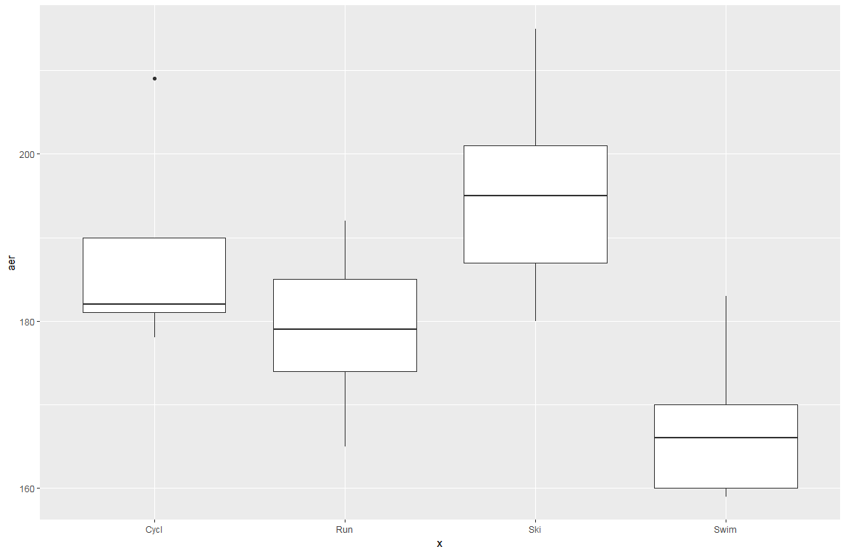
R results
kruskal.test(Sport$aer~Sport$x)
Kruskal-Wallis rank sum test data: Sport$aer by Sport$x Kruskal-Wallis
chi-squared = 9.1143, df = 3, p-value = 0.02781

